Slide 1
Yes! Woman was Born from Man’s Rib Barr Body.. The Witness
AMMAR YASEEN MANSOUR
N.B. Read the comments under the slides
Notes:
For better understanding, I advise you to follow these two methods of usage:
Firstly, see the slides one by one, and read the comments under each slide.
N.B. Some slides are copies of the precedent ones, with just a little change. These copies help for the second usage of the presentation.
Secondly, play the presentation by one click. You will then see a very short animation (video) of the entire process.

Slide 2
Notes:
The Mother Stem Cell (MSC) It contains 22 pairs of autosomal chromosomes (not presented), in addition to the chromosomes pXX (seen in figure), the precursor of both sexual chromosomes XX and XY. ( pXX = precursor of both sexual chromosomes XX and XY).

Slide 3
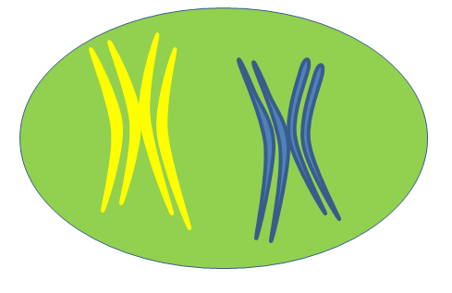
Notes:
During the asexual reproduction (mitosis), the chromatin storage of the MSC, represented here by the pXX, was duplicated in order to be equally distributed between the two daughter cells.

Slide 4
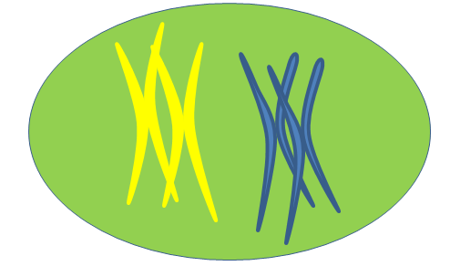
Notes:
During the asexual reproduction (mitosis), the chromatin storage of the MSC, represented here by the pXX, was duplicated in order to be equally distributed between the two daughter cells.

Slide 5
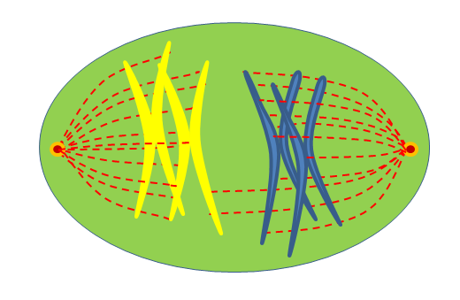
Notes:
During the asexual reproduction (mitosis), the chromatin storage of the MSC, represented here by the pXX, was duplicated in order to be equally distributed between the two daughter cells.

Slide 6
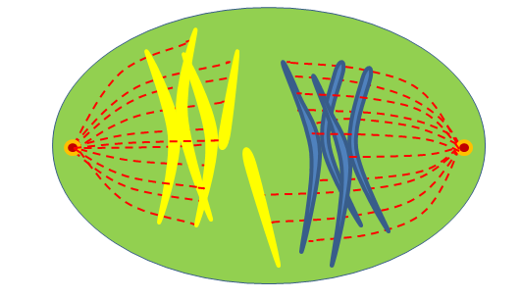
Notes:
During the anaphase and the telophase (the drawing represents the telophase), a segment of the chromosome X is stolen from one daughter cell in profit to the other daughter cell.

Slide 7
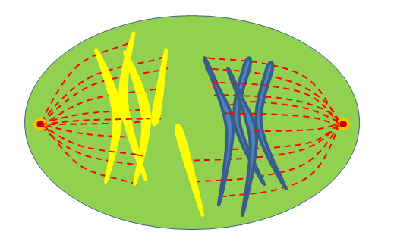
Notes:
During the anaphase and the telophase (the drawing represents the telophase), a segment of the chromosome X is stolen from one daughter cell in profit to the other daughter cell.

Slide 8
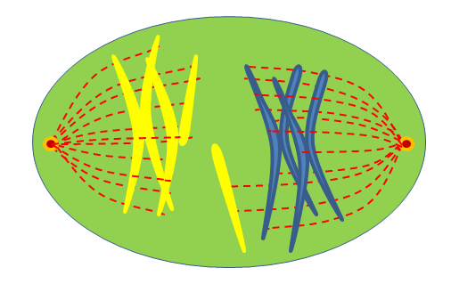
Notes:
During the anaphase and the telophase (the drawing represents the telophase), a segment of the chromosome X is stolen from one daughter cell in profit to the other daughter cell.

Slide 9
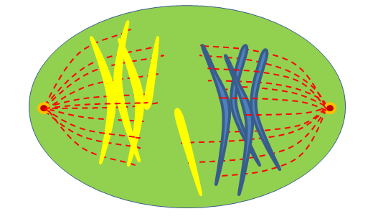
Notes:
During the anaphase and the telophase (the drawing represents the telophase), a segment of the chromosome X is stolen from one daughter cell in profit to the other daughter cell.

Slide 10
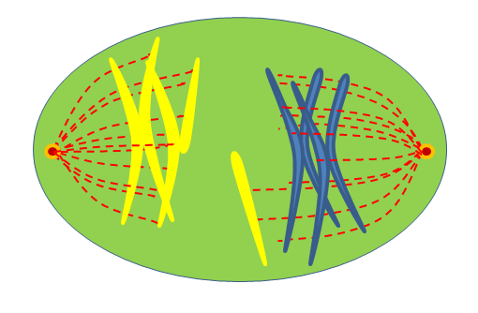
Notes:
During the anaphase and the telophase (the drawing represents the telophase), a segment of the chromosome X is stolen from one daughter cell in profit to the other daughter cell.

Slide 11
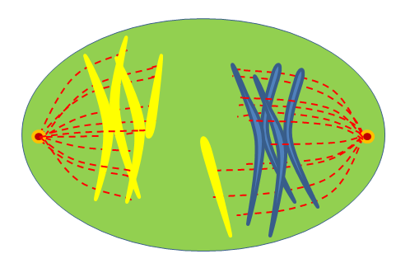
Notes:
During the anaphase and the telophase (the drawing represents the telophase), a segment of the chromosome X is stolen from one daughter cell in profit to the other daughter cell.

Slide 12
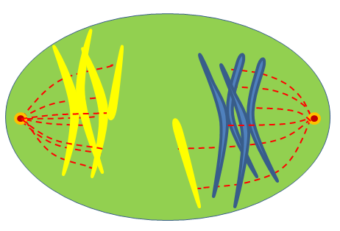
Notes:
During the anaphase and the telophase (the drawing represents the telophase), a segment of the chromosome X is stolen from one daughter cell in profit to the other daughter cell.

Slide 13
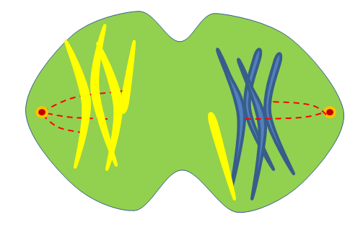
Notes:
During the anaphase and the telophase (the drawing represents the telophase), a segment of the chromosome X is stolen from one daughter cell in profit to the other daughter cell.

Slide 14
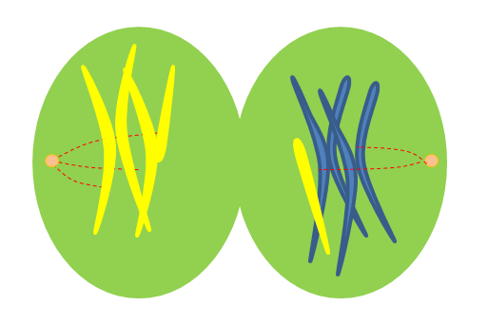
Notes:
The winner daughter cell became the human female cell with the sexual chromosomes X and X, in addition to the new element that was stolen from the other daughter cell.
Whereas, the looser daughter cell became the human male cell with the sexual chromosomes X and Y.

Slide 15
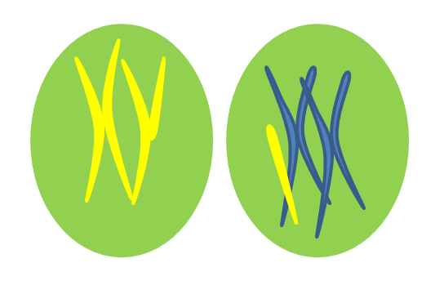
Notes:
The winner daughter cell became the human female cell with the sexual chromosomes X and X, in addition to the new element that was stolen from the other daughter cell.
Whereas, the looser daughter cell became the human male cell with the sexual chromosomes X and Y.

Slide 16
Notes:
The winner daughter cell became the human female cell with the sexual chromosomes X and X, in addition to the new element that was stolen from the other daughter cell.
The stolen rib will for ever stay in the nucleus of the woman cells, in form of Barr body, as a witness of a such mutation.

Slide 17
Notes:
The winner daughter cell became the human female cell with the sexual chromosomes X and X, in addition to the new element that was stolen from the other daughter cell.
The stolen rib will for ever stay in the nucleus of the woman cells, in form of Barr body, as a witness of a such mutation.

Slide 18
Notes:
The winner daughter cell became the human female cell with the sexual chromosomes X and X, in addition to the new element that was stolen from the other daughter cell.
The stolen rib will for ever stay in the nucleus of the woman cells, in form of Barr body, as a witness of a such mutation.

Slide 19
Notes:
The winner daughter cell became the human female cell with the sexual chromosomes X and X, in addition to the new element that was stolen from the other daughter cell.
The stolen rib will for ever stay in the nucleus of the woman cells, in form of Barr body, as a witness of a such mutation.

Slide 20
Notes:
The winner daughter cell became the human female cell with the sexual chromosomes X and X, in addition to the new element that was stolen from the other daughter cell.
The stolen rib will for ever stay in the nucleus of the woman cells, in form of Barr body, as a witness of a such mutation.

Slide 21
Notes:
The First Woman

