Slide 1
As the Sperm, The Oocyte has two types; Male Oocyte and Female Oocyte
AMMAR YASEEN MANSOUR
N.B. Read the comments under the slides
Notes:
For better understanding, I advise you to follow these two methods of usage:
Firstly, see the slides one by one, and read the comments under each slide.
N.B. Some slides are copies of the precedent ones, with just a little change. These copies help for the second usage of the presentation.
Secondly, play the presentation by one click. You will then see a very short animation (video) of the entire process.

Slide 2
Notes:
The Oogoniums reside in the ovaries and are the origin of the woman Oocytes. The Oogonium contains 46 chromosomes of which two form the sexual chromosomes XX. The two partners of the sexual chromosomes XX are not identical (as illustrated before, in another presentation titled “ Yes, Woman was Born from Man’s Rib”) One of the two X chromosome is heavier because of its relationship with the stolen rib (the yellow segment).

Slide 3
Notes:
The Oogoniums reside in the ovaries and are the origin of the woman Oocytes. The Oogonium contains 46 chromosomes of which two form the sexual chromosomes XX. The two partners of the sexual chromosomes XX are not identical (as illustrated before, in another presentation titled “ Yes, Woman was Born from Man’s Rib”) One of the two X chromosome is heavier because of its relationship with the stolen rib (the yellow segment).

Slide 4
Notes:
The Oogoniums reside in the ovaries and are the origin of the woman Oocytes. The Oogonium contains 46 chromosomes of which two form the sexual chromosomes XX. The two partners of the sexual chromosomes XX are not identical (as illustrated before, in another presentation titled “ Yes, Woman was Born from Man’s Rib”) One of the two X chromosome is heavier because of its relationship with the stolen rib (the yellow segment).

Slide 5
Notes:
The Oogoniums reside in the ovaries and are the origin of the woman Oocytes. The Oogonium contains 46 chromosomes of which two form the sexual chromosomes XX. The two partners of the sexual chromosomes XX are not identical (as illustrated before, in another presentation titled “ Yes, Woman was Born from Man’s Rib”) One of the two X chromosome is heavier because of its relationship with the stolen rib (the yellow segment).

Slide 6
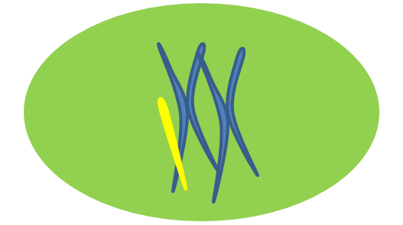
Notes:
The Oogoniums reside in the ovaries and are the origin of the woman Oocytes. The Oogonium contains 46 chromosomes of which two form the sexual chromosomes XX. The two partners of the sexual chromosomes XX are not identical (as illustrated before, in another presentation titled “ Yes, Woman was Born from Man’s Rib”) One of the two X chromosome is heavier because of its relationship with the stolen rib (the yellow segment).

Slide 7
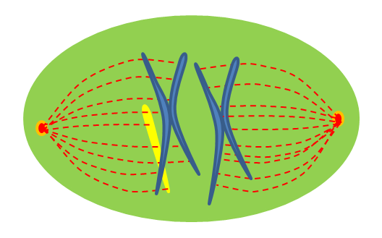
Notes:
During the meiosis, The sexual chromosomes XX is divided between the two Oocytes. The famous stolen rib (yellow segment) rests integrated within one chromosome X marking the future female Oocyte. While, the other chromosome X will be in the male Oocyte.

Slide 8
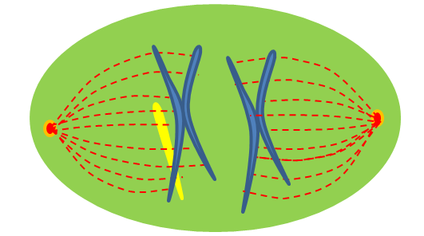
Notes:
During the meiosis, The sexual chromosomes XX is divided between the two Oocytes. The famous stolen rib (yellow segment) rests integrated within one chromosome X marking the future female Oocyte. While, the other chromosome X will be in the male Oocyte.

Slide 9
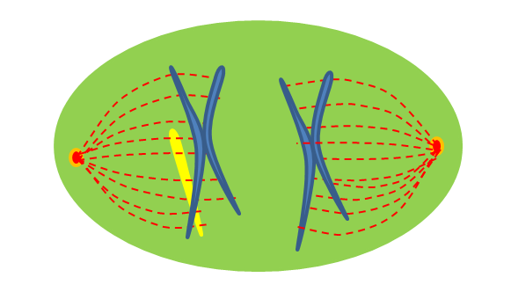
Notes:
During the meiosis, The sexual chromosomes XX is divided between the two Oocytes. The famous stolen rib (yellow segment) rests integrated within one chromosome X marking the future female Oocyte. While, the other chromosome X will be in the male Oocyte.

Slide 10
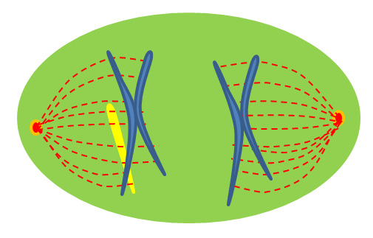
Notes:
During the meiosis, The sexual chromosomes XX is divided between the two Oocytes. The famous stolen rib (yellow segment) rests integrated within one chromosome X marking the future female Oocyte. While, the other chromosome X will be in the male Oocyte.

Slide 11
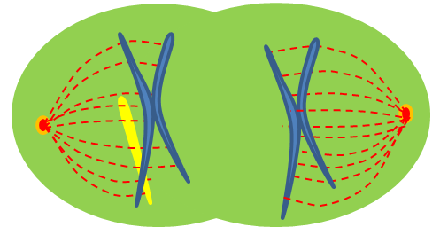
Notes:
During the meiosis, The sexual chromosomes XX is divided between the two Oocytes. The famous stolen rib (yellow segment) rests integrated within one chromosome X marking the future female Oocyte. While, the other chromosome X will be in the male Oocyte.

Slide 12
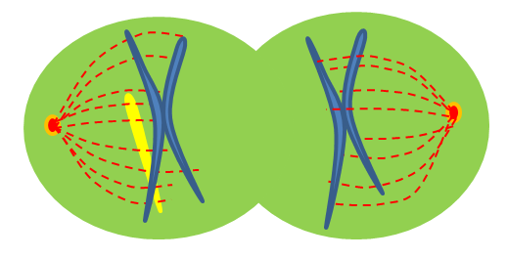
Notes:
During the meiosis, The sexual chromosomes XX is divided between the two Oocytes. The famous stolen rib (yellow segment) rests integrated within one chromosome X marking the future female Oocyte. While, the other chromosome X will be in the male Oocyte.

Slide 13
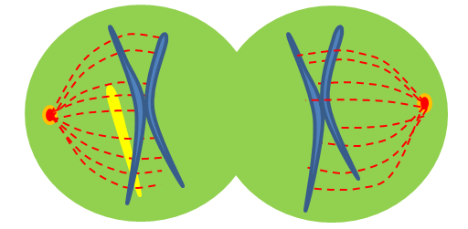
Notes:
During the meiosis, The sexual chromosomes XX is divided between the two Oocytes. The famous stolen rib (yellow segment) rests integrated within one chromosome X marking the future female Oocyte. While, the other chromosome X will be in the male Oocyte.

Slide 14
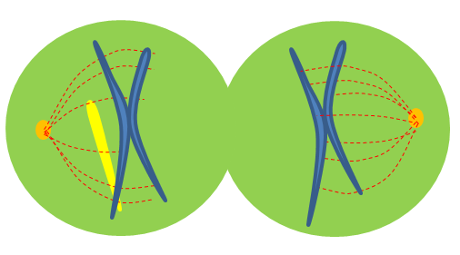
Notes:
During the meiosis, The sexual chromosomes XX is divided between the two Oocytes. The famous stolen rib (yellow segment) rests integrated within one chromosome X marking the future female Oocyte. While, the other chromosome X will be in the male Oocyte.

Slide 15
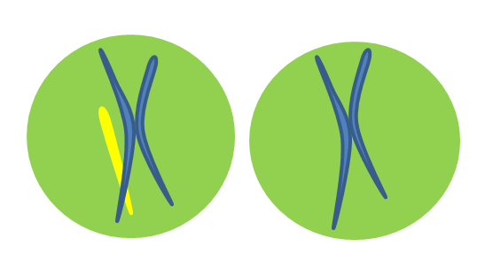
Notes:
During the meiosis, The sexual chromosomes XX is divided between the two Oocytes. The famous stolen rib (yellow segment) rests integrated within one chromosome X marking the future female Oocyte. While, the other chromosome X will be in the male Oocyte.

Slide 16
Notes:
The male Oocyte, It cannot give but a male embryo. If it is fecundated by a compatible spermatozoid (i.e. spermatozoid Y), the process of creation goes on. Provided, it is fertilized by an incompatible spermatozoid (i.e. the spermatozoid X), the process of creation is eventually aborted.

Slide 17
Notes:
The male Oocyte, It cannot give but a male embryo. If it is fecundated by a compatible spermatozoid (i.e. spermatozoid Y), the process of creation goes on.

Slide 18
Notes:
The male Oocyte, It cannot give but a male embryo. If it is fecundated by a compatible spermatozoid (i.e. spermatozoid Y), the process of creation goes on.

Slide 19
Notes:
The male Oocyte, It cannot give but a male embryo. If it is fecundated by a compatible spermatozoid (i.e. spermatozoid Y), the process of creation goes on.

Slide 20
Notes:
The male Oocyte, It cannot give but a male embryo. Provided, it is fertilized by an incompatible spermatozoid (i.e. the spermatozoid X), the process of creation is eventually aborted.

Slide 21
Notes:
The male Oocyte, It cannot give but a male embryo. Provided, it is fertilized by an incompatible spermatozoid (i.e. the spermatozoid X), the process of creation is eventually aborted.

Slide 22
Notes:
The female Oocyte, It cannot give but a female embryo. Its chromosome X is of a higher molecular weight than the chromosome X found in the male Oocyte. This dissimilarity is due to the famous stolen rib (yellow segment), which is integrated in (shown here), or is attached to, or just lies beside it (not presented here)

Slide 23
Notes:
The female Oocyte, It cannot give but a female embryo. If it is fecundated by a compatible spermatozoid (i.e. spermatozoid X), the process of creation goes on.

Slide 24
Notes:
The female Oocyte, It cannot give but a female embryo. If it is fecundated by a compatible spermatozoid (i.e. spermatozoid X), the process of creation goes on.

Slide 25
Notes:
The female Oocyte, It cannot give but a female embryo. If it is fecundated by a compatible spermatozoid (i.e. spermatozoid X), the process of creation goes on.

Slide 26
Notes:
The female Oocyte, It cannot give but a female embryo. Provided, it is fertilized by an incompatible spermatozoid (i.e. the spermatozoid Y), the process of creation is eventually aborted.

Slide 27
Notes:
The female Oocyte, It cannot give but a female embryo. Provided, it is fertilized by an incompatible spermatozoid (i.e. the spermatozoid Y), the process of creation is eventually aborted.

